Slide 1


Drone Based Mapping and Ground Based Robotic Precision Spray System for Field Crops

Slide 2
Team Roles (Sprint 2)
Logan Sutton
  Frontend & Backend structure and interactions
  File storage for orthophotos
  Explore path generation for robot
Gil Rezin
  Creating field maps from orthophotos
  Clustering NDVI values for grid overlay
  Identify unique clusters from cell values

Slide 3
Sprint 2 Objectives/Goals
Expand functionality in user interface
  Add orthophoto gallery
  View NodeODM report
Generate and store orthophotos using NodeODM
  Download generated orthophotos and store in file structure
  Generate a manifest with relevant info
Create field maps with NDVI values
  Utilize Field ImageR to create field maps from generated orthophotos
Utilize clustering for data analysis
  Allows grid sections to represent area of field
Explore waypoints for robot pathing

Slide 4
Feature Implementation (Logan)
Polling for process completion
  Download orthophoto and store with manifest
  Frontend has option to pass name of task, stored in manifest
View for generated orthophotos
  Includes report view
  Options to download photo and report
File structure for completed tasks

Slide 5
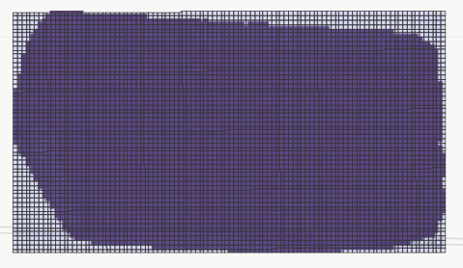
Feature Implementation (Gil)
NDVI Calculation
Field Segmentation
  Break up into cells
  Rewriting of FIELDimageR function(s)
Cluster identification
  DBScan algorithm utilized
Explore options for pathfinding
  Hamiltonian algorithms
  Custom heading adjustments
  Work-in-progress

Slide 6
Figma Prototype (not needed)
Note: client wanted AI generated UI, minimal time spent on design

Slide 7
Kanban Board

Slide 8
App Demo

Slide 9
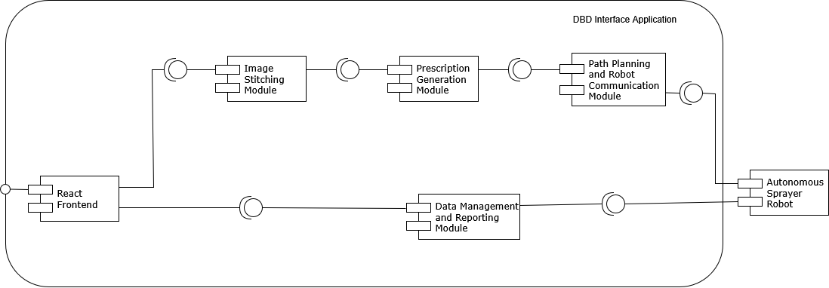

Slide 10
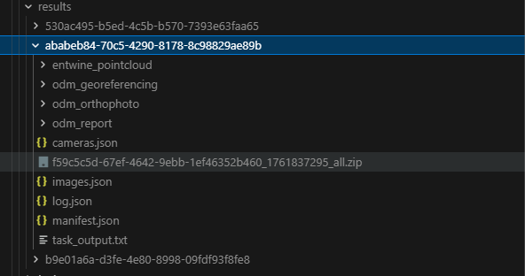
Data Storage Architecture
File hierarchy (accessible by backend)

Slide 11
Achievements and Challenges
Achievements
File structure
  Allows for easy field map code integration
  Storage is convenient for route handling
Frontend is 80% complete
  Next step: implement backend to serve all frontend necessities
Field processing mostly complete
Challenges
Large frontend file uploads fail
  Refactor to file streaming or different approach
Lots of work for just 2 people
  Discovered that “easy” steps are more involved than anticipated
  Progress isn’t as quick as expected
Communication challenges with hardware team
  Converting prototypes to integrated system may prove challenging
  Concerns over potential rewrites during integration

Slide 12
Next steps
Complete docker container setup to host frontend and backend
Refactor file upload module to handle large files
Implement FarmNG waypoint creation
  Future: integrate with field map (coordinates)
Prescription generation
  Allow for farmer to choose between high, low, and no spray for field areas

Slide 13
Gen AI usage
Frontend creation and modifications
  Per client request
Suggesting possible fixes to small issues
  Ex. proposing file streaming as solution to large file problem
Debugging linter errors

Slide 14
Gen AI
Checks
  Always verified code for expected output
  Reviewed AI output for clarity and correctness by reviewing requirements
Retrospective
  AI performed well for user UI creation
  Helped with docker container creation (WIP)
  Created well formatted and coherent text for documentation
  Areas to improve
    Ensure prompts are specific to reduce AI errors

Slide 15
Thank you!
We’re excited to continue developing this system in Sprint 3!

